Slide 1
Models (1):
Scale-Free and Modular Networks
Sergi Valverde
Modelling Complex Diseases
UPF 2018

Slide 2

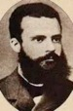
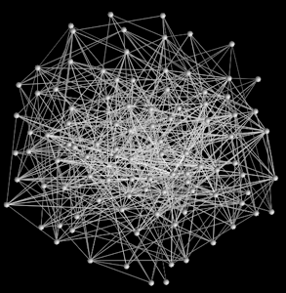
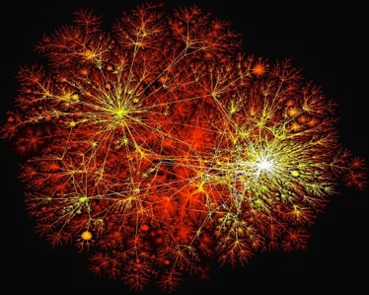
Network Models: What they look like
Random
Scale-Free
P. Erdös
V. Pareto
P(k)
log P(k)
g
k
log k
<k>
Notes:
Random networks
One of the most important predictions of random networks is that, in spite of having random interactions, the result is a very **democratic network**: The majority of nodes have approximately the same number of links. It follows a Poisson Distribution. If the society was random, as Erdos-Renyi envision through their model, each of us would have approximately the same number of friends, there would be no hugely popular individual and no single individual would be left behind.
Scale-free networks
However, real-world networks do not fit the random model. For example, our economic systems are characterised by strong inequality. "20% of the people possess the 80% of the full wealth”. The internet shows a similar pattern, which is radically different from the democratic prediction of the random network theory. Many routers have only one or two links. And only a very small fraction of hugely connected nodes. This type of network is very heterogeneous system and cannot be explained with random network theory. We now call this networks scale-free.
What it does it mean? The mathematical distribution is a power-law, that is very different from the Poisson distribution. One of the most important predictions of scale-free networks is the presence of outliers in the system, the hubs. These nodes are present in real networks and they play an important role in many systems. For example, in the WWW they are popular web sites like Google, Facebook, in movies are popular actors that appear everywhere, in the patent citation network they are innovations that open new technological domains, like the CT patent by G. Hounsfield.

Slide 3
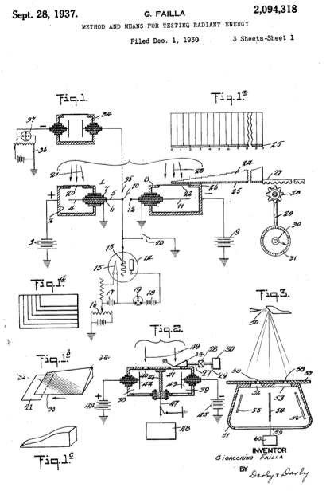
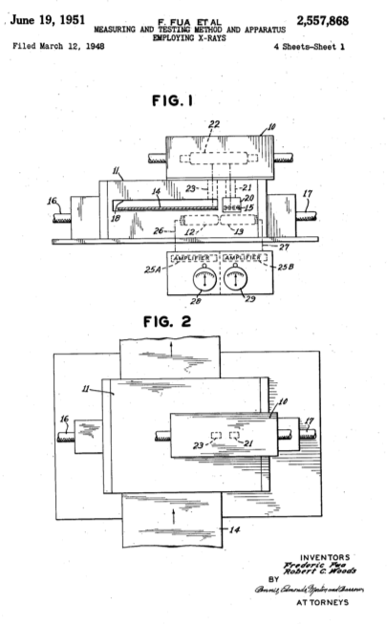
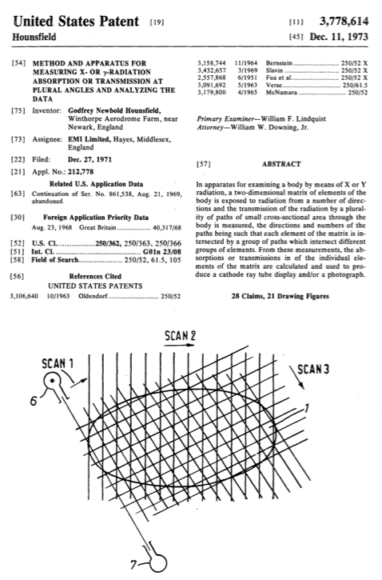
Patent Citations
1930 - 1937
1944 - 1951
1969 - 1973
Gioacchino Failla
Frederic Fua & Robert C. Woods
Godfrey Hounsfield
2,094,318
2,557,868
3,778,614
A method of measuring the quality of electromagnetic radiations such as X-rays for testing metal foil and the like
Accurately testing thickness of materials such as metal by X-rays in the fast moving product and without touching it
Computer assisted Tomography
Notes:
- The analysis of patent documents provides a standard, more exhaustive approach to study the evolution of technology. - Instead of comparing the function and shape of inventions, a much better approach seems to compare their corresponding patents to measure their divergence and track their evolution.
1) Hounsfield combined his interest with computers together with an interest in X-rays. Invented in 1895, X-rays were used to image bodies in 2-D dimensions from a fixed position. Hounsfield's idea was to scan a 3-D object, in particular, a human head, from many directions and combining this information with the aid of a computer. Eventually, he got the Nobel Prize in Medicine in 1979 for this invention.
2)

Slide 4
Patent Citation Networks
14 years
22 years
2,094,318
2,557,868
3,778,614
Valverde S, Solé RV, Bedau MA, Packard N (2007)
Topology and evolution of technology innovation networks.
Phys Rev E 76:056118.
Notes:
Stringed Musical Instrument (Carmelo Gugino) F1935 I1938
http://www.google.com/patents/about?id=tcZiAAAAEBAJ&dq=2113446
Guitar Body or Similar Article (Ralph G. Smith) F1970, I1972
http://www.google.com/patents/about?id=VqY8AAAAEBAJ
Electric Guitar (Clyde E. Edwards) F1978, I1980
http://www.google.com/patents/about?id=75o9AAAAEBAJ

Slide 5
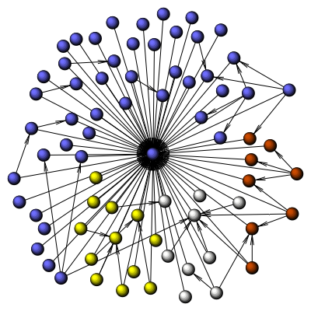
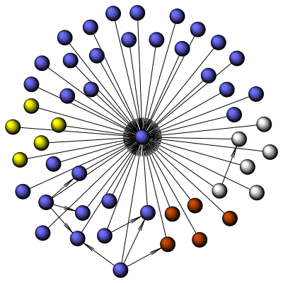
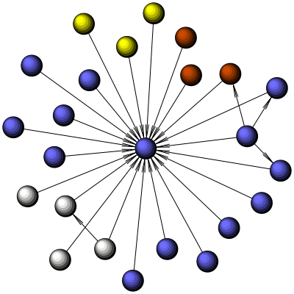
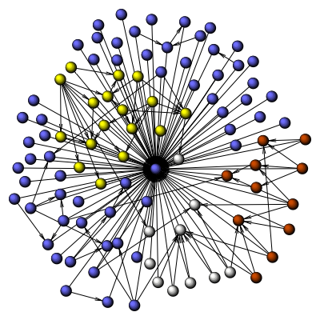
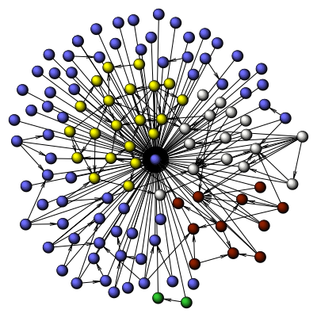
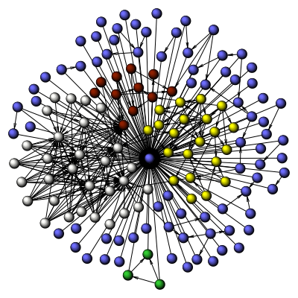
Evolution of the CT Patent Citation Network
1973
1980
1985
1990
1995
2004
Notes:
Modules?

Slide 6
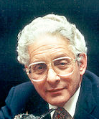


Preferential Attachment: Models of Network Growth
D. de Solla Price
Probability
Number of Citations
(Price, 1965) & (Price, 1976)
Notes:
The networks that result from Price’s model are often called ‘scale-free’ or ‘power-law’ networks. These are networks in which the distribution of the number of connections of each node is not a normal distribution - instead it follows what is called a power-law distribution. Power law distributions are different from normal distributions in that they do not have a peak at the average, and they are more likely to contain extreme values.
The preferential attachment mechanism is one way to generate scale-free networks. But there are other mechanisms for creating scale-free networks.
Price's major scientific contributions include:
studies of the exponential growth of science and the half-life of scientific literature (Price 1963);
quantitative studies of the network of citations between scientific papers (Price 1965), including the discovery that both the in- and out-degrees of a citation network have power-law distributions, making this the first published example of a scale-free network;
a mathematical theory of the growth of citation networks, based on what would now be called a preferential attachment process (Price 1976);[2]
an analysis of the Antikythera mechanism, an ancient Greek clockwork calculator (Price 1959, 1974).
http://es.wikipedia.org/wiki/Derek_John_de_Solla_Price
Price’s preferential attachment model for citation networks:
. Each paper is generated with ‘m’ citations (mean)
. New papers cite previous papers with probability proportional to their in-degree (citations)
. what about papers without any citations?
.. Each paper is considered to have a “default” citation
.. Probability of citing a paper with degree k, proportional to k+1
=> Power-law with exponent \alpha = 2 + 1/ m

Slide 7
Preferential Attachment
Exploring the role of history and amplification effects in the emergence of hubs
How many nodes are “hubs”?
How many have only a few links?
Does some low k node ever become a hub? How often?

Slide 8
Modularity

Slide 9
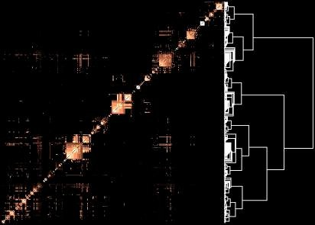
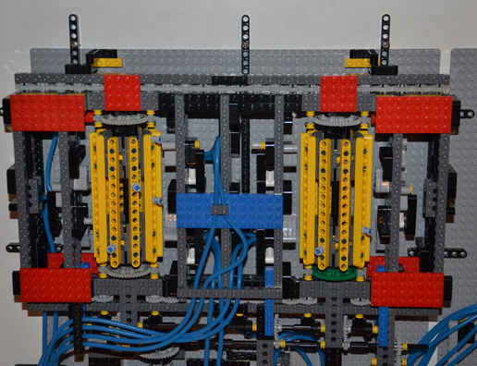
Hierarchical Organisation of Networks
To build complex things, both nature and engineers use modules
H. A. Simon, “The Architecture of Complexity” (1962)
LEGO Turing Machine
H. Jeong et al., Nature 407, 651-654 (2000)
E. Ravasz and A.-L. Barabási (2003)
Notes:
To build complicated things, both nature and engineers use modules. Biological and technological systems both exhibit a common pattern of modular organization. A modular system is formed by quasi-independent parts that not only are highly integrated within themselves but also display a degree of interdependency among themselves.
But how modularity evolved in the first place? The leading theory argues that modularity evolves because it is useful. Modularity is considered to be a prerequisite for the adaptation of complex organisms and their evolvability. It has been argued that modularity is likely to have been selectively favoured by evolution. In that case, explaining its origins would require a functional view of biological networks.
However, there are different, non-adaptive hypotheses that we can test with network theory.
——
Many real networks are organized into many small highly connected modules that combine in a hierarchical manner into larger units, with their number and degree of clustering following a power law.
We can use system-independent network metrics to compare the architecture of different systems. For example, many complex networks are characterized by large-scale hierarchical organizations. How are flows distributed within networks? Are there are prominent elements at the top of the hierarchy (1) that share and control resources or (2) they tend to avoid one another?
We can use the same metric (i.e., the correlation between node degree and clustering) to compare the structure of metabolic networks in three organisms: Aquidex aeolicus (archaea) (C), Escherichia coli (bacterium) (D), and Saccharomyces cerevisiae (eukaryote). All these networks display a similar pattern of hierarchical organisation, i.e., small groups of nodes organise in a hierarchical manner into increasingly large groups, with independence of the specific details and nature of the system.
Hierarchical organization in complex networks
http://journals.aps.org/pre/abstract/10.1103/PhysRevE.67.026112
http://en.wikipedia.org/wiki/Hierarchical_network_model
Ravasz
No modularity vs

Slide 10
Community Detection
u1
u2
u3
u4
u5
u6
u1
u5
u1
u2
u3
u4
u3
u4
u5
u2
u6
u6
Network
Matrix
Modularity measures the presence of dense clusters of interdependent nodes
Notes:
What is modularity and why we are interested in measuring it? If you were ever interested in whether networks are composed by groups and we wanted to identify these groups, you will be interested in measuring modularity. Essentially, this metric allows you to identify groups embedded within a network. For example, we can argue that this network has a natural division in two groups.
Finding logical and plausible modules in task is not a simple task. We need computational tools to discover structural patterns in very large networks. Given a network we can cluster nodes with a computer algorithm that maximises a quality measure called modularity. The outcome of this optimisation is a partition in modules or communities.
http://www.news.cornell.edu/stories/2013/01/scientists-find-holy-grail-evolving-modular-networks

Slide 11
How to find modularity?
(1) Divide up the network
(2) Calculate the modularity value (Q)
(3) Repeat until a solution is optimised
Notes:
How we can measure modularity? Modularity requires an optimisation method to obtain the modularity value. This algorithm consists of the following steps.

Slide 12
(1) Divide up the network
Notes:
First thing is to pick a way to partition the network. For example, the previous network accepts a division like this.

Slide 13

(2) Calculate the modularity value (Q)
[
-
]
Observed fraction
of links in group
Expected fraction
of links in group
for each of
the modules
Notes:
Then, what we have to do is to calculate the modularity based on that partition. Modularity is represented by “Q”. For each of the modules, we compare the fraction of the links between nodes in the group minus the expectation. Then, we are just looking for the groupings with the highest density of links, more so than expected by random chance.

Slide 14

(2) Calculate the modularity value (Q)
Number of Modules
Taking square to obtain link probability
Number of links between
nodes in module ’s'
Sum of degrees
of nodes in module ’s'
Number of links
in the network
Girvan and Newman PNAS 99:7821 (2002)
Notes:
This is Girvan-Newman’s definition for calculating modularity and this is a widespread method. For each module in the partition we have to compute several quantities of interest. The fraction of links within a group is calculated by l_s = the number of links between nodes in module ’s’ divided by L = the number of links in the network. We also define the degree, or number of links a given node has. Then, we have to compare observed fraction with the expected fraction of links in the group. To do that, we subtract the sum of the degrees of nodes in the module ’s’. The squared term gives the expected probability of interaction or average fraction of links within a module.

Slide 15


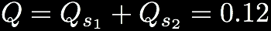
Example (1/2)
s1
s2
Notes:
Assume that we start our optimisation process with this particular partition.
1) Lets compute the modularity contribution of the first module (s_1). Here we have l_s = 1 internal link which is divided by the number of links L=7 in the network. To compute the random expectation we have the sum of the degrees of nodes d_s = 2 + 2 = 4, which divided by 2L gives the expected degree of a node within the module. Taking the square of this fraction yields the probability to observe a link within the module.
2) Then we do essentially the same computation at the other side of this partition.
3) We add them up and get the value of modularity for this example network.
Notes:
(1/7) = 0.14285714285714285
(4/14)^2 = 0.08163265306122448

Slide 16

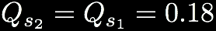
Example (2/2)
s1
s2
Notes:
We have to repeat this process until the solution is optimised. We will generate a new partition and compute the modularity again until the value Q is no longer increasing.
3) in this case, we obtain a value of modularity Q = 0.36. This is a better partition than the one obtained before.

Slide 17
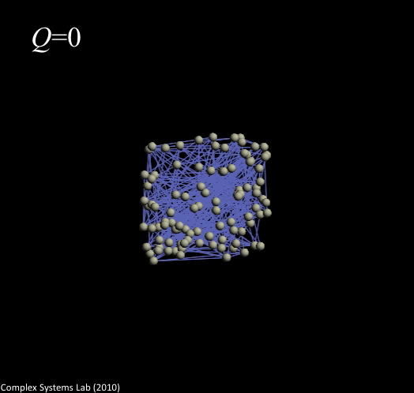
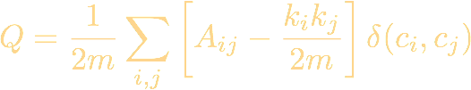
Energy models and modularity reveal communities
F
a
i
j
F
r
i
j
Notes:
Algorithms like modularity or energy-based layouts help us to find structure. The first time we load a real network (spatial or not) what we get is something like this. The hairball is not a very informative representation. These algorithms place densely connected nodes at nearby positions or in the same module, and place sparsely connected nodes at distant positions or in different clusters.The separation of communities in an optimal layout is inversely proportional to (some power of) the density exchanged between them.

Slide 18
Network Modularity
Finding communities in random modular networks

